Slide 1
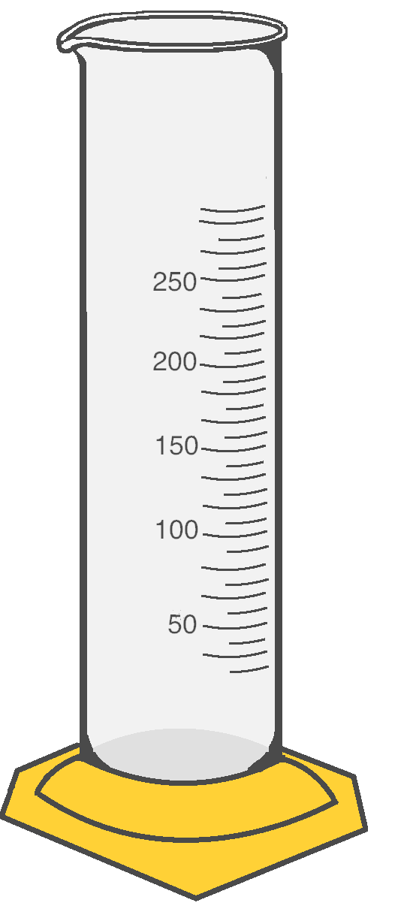
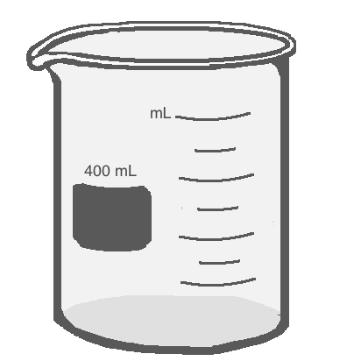


Scientific Method

Slide 2
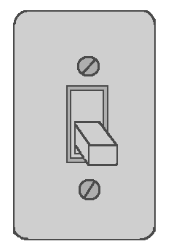
Scientific Method
Every time you solve a problem, you are use the Scientific Method.
You use some form of the Scientific Method everyday without even thinking about it!
For instance, when you walk into a dark room you are faced with a problem: you can’t see. You know that you can turn the lights on with a light switch. You test this by flipping the switch.
If the lights come on, you can conclude that the lights were turned off. If not, you then maybe the bulbs are burnt out. To solve that simple problem, you naturally follow the steps of the scientific method!

Slide 3
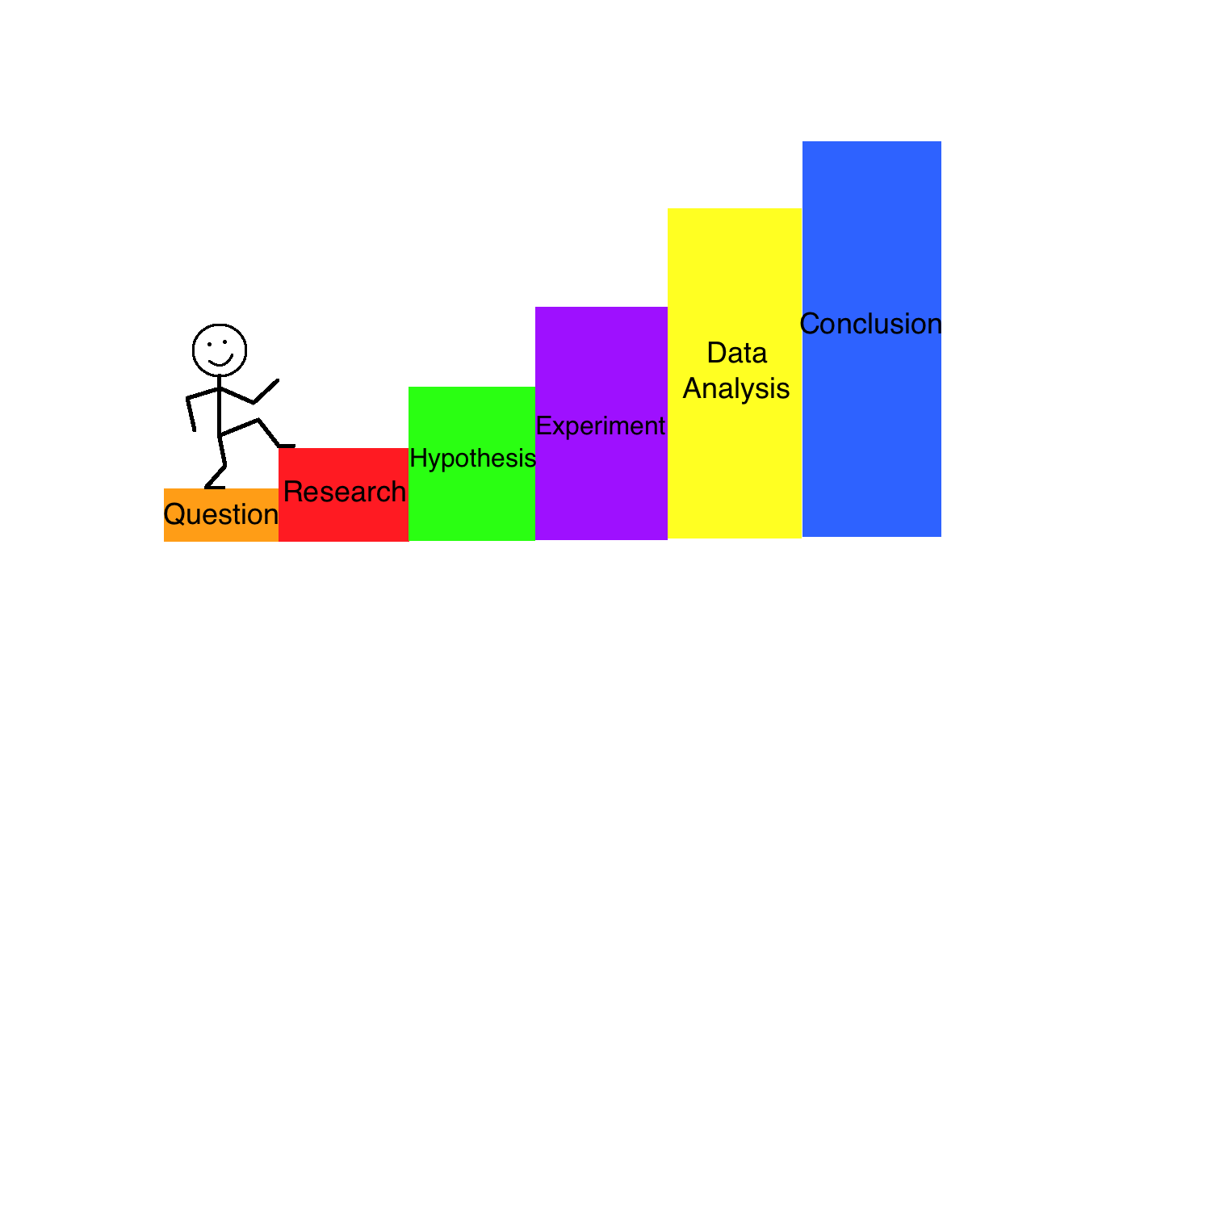
Steps of the Scientific Method
Problem/Question
Research
Hypothesis
Procedure/Experiment
Analyze data
Conclusion
Notes:
Make sure to emphasize to students that the Scientific Method is NOT just a list of steps. We use the scientific method everyday to solve problems we are faced with. If anything, the Scientific Method is just a glorified version of our own natural thought process. However, to go through this process correctly, we cannot neglect the natural chain of events. A question leads to a guess, which leads to us searching for the answer. To prove our guess correct we have to test it by changing something. The proof we gain from changing (testing) will lead us to our conclusion.

Slide 4

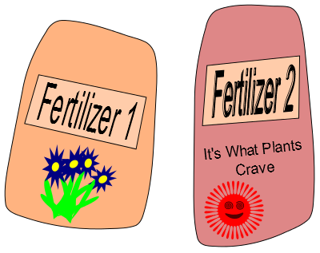
Question
Everyday you are faced with problems or come up with questions. Having a Question is the first step to finding the solution.
For example, you bought seeds for your favorite flower but are not sure what the best fertilizer to use is.
You have two types of fertilizer in your garage so you come up with the Question:
Which fertilizer will make my flower grow taller: Fertilizer 1 or Fertilizer 2?
Notes:
Make sure that students realize that the beginning of the Scientific Method process can begin with a Question OR a Problem…they can be interchangeable. The Scientific Method helps us solve everyday questions or bigger problems that lead to multiple questions.

Slide 5


Research
To begin answering your question, you have to Research the topic your experiment is on.
For example, if you researched plant fertilizers you would find that they have different nutrients in them. Some are better for making plants bigger and some are better for making them flower more.
Different fertilizers have different amounts of these nutrients for the plants.
You see Fertilizer 1 has a lot of flowering nutrients in it while Fertilizer 2 has lot of growth nutrients.
Notes:
Students need to understand that to conduct a scientific experiment correctly, they must research the topic they wish to learn about beforehand. This is because you cannot make an educated guess without having educated yourself on the topic you’re exploring. Researching the topic will also provide enough information to lead to a more accurate and sound experiment.

Slide 6

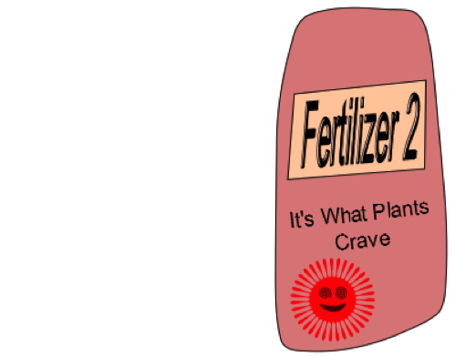


Hypothesis
+
=
After researching your topic you have enough information to predict how your experiment will go. This prediction is called a Hypothesis.
If you use Fertilizer 1 on Plant A and Fertilizer 2 on Plant B, then you can expect Plant B to grow taller because its fertilizer has more growth nutrients.
Notes:
The Hypothesis is a crucial step in the entire Scientific Method. This step is virtually what the entire science experiment is founded upon because it highlights the chosen independent and dependent variables. Students should be aware that this statement is not just a “guess”, it has to include what will be changed in the experiment as well as the reason behind the predicted result. Depending on the grade level or standards your teaching is based upon, you may want to emphasize the “if, then, because” method to writing a Hypothesis. This method will make sure to highlight the independent variable, dependent variable, and research that the experiment will be based upon.

Slide 7


Design the Experiment: Variables
To make your Experiment, you need to figure out what all can affect your outcome
In other words, you need to figure out what the Variables are. A variable is something that changes (varies) or can change. Our variables are:
There are two types of variables:
Independent Variable: It does not depend on the other variables. This is the variable that you control.
Dependent Variable: This variable depends on the other variables. It is the variable that you are trying to measure.
Type of Fertilizer
The day you measure height
Sunlight
Planting Pot
Water
Height of the plants
Soil
Type of Seeds
Ruler
You can see that some of the variables we listed we are not trying to test. We only want to see how different fertilizers affect plant height. This is why we control the variables that we are not testing.
Notes:
Designing the Experiment is a type of extension upon the Hypothesis to provide evidence as to whether your hypothesis will be supported or not supported. The design of the experiment must be based upon the independent variable that is being changed. In other words, make sure that students know that when it comes to Independent Variables, they can only change ONE thing that they are personally controlling in the experiment. Make sure that the change you are looking to measure (dependent variable) is measurable either qualitatively or quantitatively. Heavily emphasize to students this point: all dependent variables MUST be measurable in order to provide evidence for the Hypothesis.

Slide 8
Controls
Controls are the part of the experiment that remain the same no matter what.
The controls for this experiment are variables that we want to keep the same for Plant A and Plant B
Controls
Type of Seeds: We want Plant A and Plant B to be the same type of plant.
Amount of Sunlight: we want both plants to get the same amount of sun.
Amount of Water: We want both plants to get the same amount of water.
Soil: We want both plants to grow in the same type of soil
Amount of Fertilizer: We want to use the same amount of fertilizer on the plants, but different types. Only the type of fertilizer should affect our experiment.
Ruler: We want to use the same ruler on each plant to make sure we measure fairly.
Planting Pots: Grow both plants in the same size and type of planting pot.
Notes:
This is an extremely important part of a scientific experiment. Make sure that the students understand that if they are doing any type of comparison, ALL aspects of the experiment, except for the Independent Variable, MUST remain the same for the subjects being compared. They must also notate these controls somewhere to refer to if the experiment yielded abnormal results or if they wish to perform the experiment again. It only takes one aspect of the experiment not being the same for multiple subjects to make the entire experiment invalid.

Slide 9
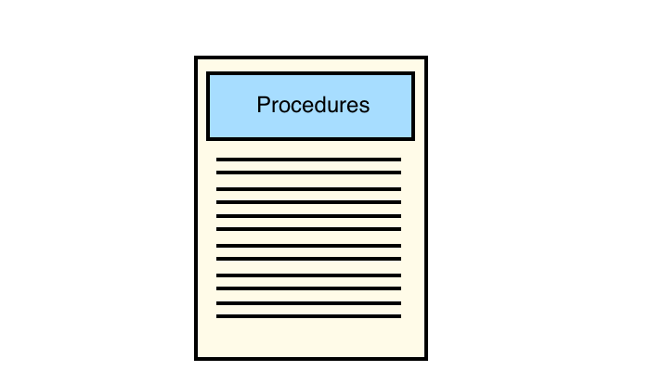

Procedures
Procedures are the directions for an experiment.
You should write your procedures so that anyone could do the EXACT same experiment as you did!
If you are writing your own procedures, be sure to include:
Measurements for all of the materials you used
The unit (gram, liter, centimeter) at the end of a number measurement
When to make measurements and record the data
How much time to wait for certain parts of the experiment
List all the controls
Describe how to change the independent variable
Describe how to measure the dependent variable
List any tools that will be used
Notes:
Students need to have a basic comprehension of the way procedures must be written in a way that can allow for repetition of the experiment by others. In other words, make sure that students get in the habit of writing HIGHLY detailed Procedure pages (including all measurements, processes, and controls).

Slide 10

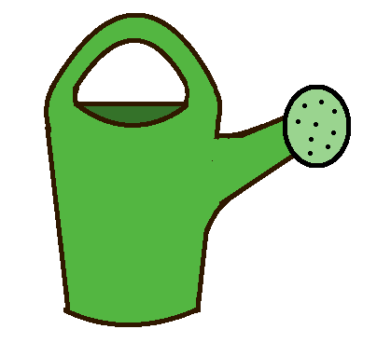
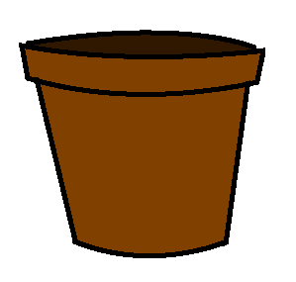
Perform the Experiment
You plant the seeds for Plant A and Plant B with the same amount of soil, water, sunlight, and fertilizer.
You give Plant A Fertilizer 1 and Plant B Fertilizer 2.
You record the heights of Plant A and Plant B for 4 days in a row once they start sprouting.
A
B
Notes:
After the controls and variables have all been accounted for and the materials are set up, it is finally time to perform the experiment! A major point in performing the experiment that the kids need to understand is that they must perform the procedures EXACTLY as they are written. If they are creating the science experiment themselves, they need to be VERY conscious as to whether or not their procedures are detailed enough to be repeated.

Slide 11

Make a Table
Data is a collection of results and observations that you can refer to later on to help you learn about what happened during your experiment. To organize the data better, we use Tables.
Before starting your experiment, you will draw a blank table and then fill it in as you make observations/collect data.
Tables have columns (vertical – like columns on buildings) and rows (horizontal – like rows of corn across a field).
Variable 1 | Variable 2 | Variable 3 | Variable 4
Data | Data | Data | Data
Data | Data | Data | Data
Data | Data | Data | Data
Notes:
Although they seem like an afterthought, tables are crucial in expressing the data fully and accurately. This is the place where the full effects of the independent variable on the dependent variable is first visible as data. It is important to emphasize that when they are creating their tables that they USE UNITS. Make sure they understand that it is NEVER acceptable to simply record numbers, this will cause their data to be invalid.

Slide 12
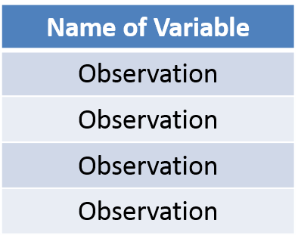
Tables: Columns
Each column of a table is for one variable. If you have three variables, then you will need three columns.
In our experiment we have three variables.
The Day (independent variable)
Height of Plant A (dependent variable)
Height of Plant B (dependent variable)
This is a Column
The top of the column is where you put the name of your variable.
Notes:
This is an optional slide to break down the table if your class is new to the material or having difficulty remembering the basic set up. Make sure to express the difference between columns and rows as simply as it truly is. However, when it comes to variables, make sure that they understand the way variables interact with the columns and rows.

Slide 13
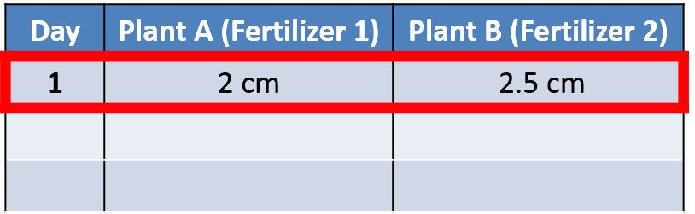
Tables: Rows
The data within a row of a table is related. So, Rows help us organize sets of related data. For example, all of the data on our first row below is from the first day and all of the data taken on the second day will go in the second row.
Let’s say that on Day 1 you measure Plant A to be 2cm tall and Plant B to be 2.5 cm tall.
The first row has each of these observations recorded in the correct columns. The Day column has a 1 in the first row, the Plant A column has 2cm in the first row, and the Plant B column has 2.5 cm in the first row.
This is the first row where we put our first observation for each variable.
This is a Row
Notes:
This is an optional slide to break down the table if your class is new to the material or having difficulty remembering the basic set up. Make sure to express the difference between columns and rows as simply as it truly is. However, when it comes to variables, make sure that they understand the way variables interact with the columns and rows.

Slide 14
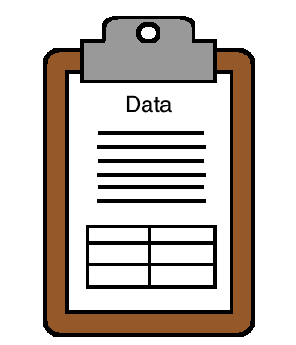
Record the Data
You continue to make measurements of the plants for each day and record the following values:
Day 1: Plant A was 2 cm tall and Plant B was 2.5 cm tall
Day 2: Plant A was 7.5 cm tall and Plant B was 10 cm tall
Day 3: Plant A was 13 cm tall and Plant B was 17 cm tall
Day 4: Plant A was 15 cm tall and Plant B was 25 cm tall
Below is how you would record this data properly in a table:
Day | Plant A (Fertilizer 1) | Plant B (Fertilizer 2)
1 | 2 cm | 2.5 cm
2 | 7.5 cm | 10 cm
3 | 13 cm | 17 cm
4 | 15 cm | 25 cm
Notes:
Make it clear to students how the table is essentially the blank template for their data. Once they have set up the table, they can THEN perform the experiment and record the data. Emphasize again that UNITS are CRUCIAL. Neglecting to record the units along with the numerical data will lead to invalid data. If you are using only the PowerPoint version of this Lesson, you may want to refer to the Worksheet included in the Lesson plan to give your class extra practice on becoming comfortable with graphs. If you are using the interactive online module, there will be an opportunity for your class to practice working with tables using one of the interactive activities.

Slide 15
When you analyze your data, you are trying to make sense of it and learn from it. You should put your data into charts and graphs to help you view your data better.
Charts and graphs help make the data from your table more visual. This will help you spot trends and reach conclusions.
One great way to visualize data that you want to compare, like heights or amounts, is with Bar Graphs.
Analyze the Data
Notes:
This is a major step in their entire experiment. Next to running the experiment, this is the most important step towards providing evidence for the hypothesis. The analysis of data is an opportunity for the student to express their data visually and comprehensively. As explained in proceeding slides, there are various ways to express and analyze data, all of which provide different perspectives. These different perspectives collectively allow the student to reach a very accurate conclusion, regardless of whether it supports their hypothesis or not.

Slide 16
Bar Graphs
Effect of Type of Fertilizer on Plant Growth
Y Axis
30
Bar Graphs are used to show the total change in something.
The Independent Variable (the type of fertilizer used) goes on the X Axis and the Dependent Variable (the height of the plants) goes on the Y axis.
By displaying our data with a Bar Graph, we can easily compare the height of Plant A to Plant B and see that Plant B grew taller
25
20
Plant Height (cm)
15
Plant A
Plant B
10
5
X Axis
Fertilizer 1
Fertilizer 2
Type of Fertilizer Used
Notes:
Bar graphs are the simplest way to display change between two subjects. This slide does not go into deep detail about the set up of the graph to avoid over-complicating the basic concept (in case this is being taught to lower grade levels). However, there are slides that can be reached regarding the very detailed break-down of graph set up and the different types of graphs and their functions. However, the main purpose of this slide is for students to see that Plant B grew larger than Plant A from a visual representation.

Slide 17
Conclusion
From our data, we conclude that our hypothesis was correct and Fertilizer 2 helped Plant B grow taller than Plant A.
We concluded that Fertilizer 2 helps plants grow taller, but can we say it works every time?
What should we do to increase our confidence that Fertilizer 2 makes plants grow taller?
There are two things you should do:
Look over all of your data and make different types of charts and graphs to spot any patterns and trends that will help you understand what is happening better.
Perform the experiment several more times. The more Trials you use, the stronger your data is and the accurate your conclusion will be.
(The following slides will incorporate additional graphing explanations and contextual examples.)
Notes:
The conclusion is the point at which the entire experiment derives its purpose. This is where the analyzed data is met with reasons, causes, and results. This is also the point where the Hypothesis is either supported or not. Without enough data and proper representations and analysis of that data, an accurate conclusion can not be drawn. Emphasize to students that the conclusion depends on all aspects of the scientific method being done properly to reach an accurate answer. If all of those parts are done correctly, then a conclusion can be drawn that solves the problem at hand and leads to answers for previous and even future questions!

Slide 18
Graphs
Y Coordinates
Y axis
7
Graphs display data so that we can see the relationship between two or more variables and better understand our data.
A graph has two main lines, called axes, that meet at the origin at a right angle. The vertical line is called the Y Axis and the horizontal line is called the X Axis. Each axis is like a number line and the numbers on the axis are called coordinates.
We use the Y Axis to show the Dependent Variable and the X Axis to show the Independent Variable.
6
5
4
3
2
Origin
1
X axis
0
X Coordinates
1
2
3
4
5
6
7
Notes:
This module is designed to introduce graphing to children that have never been exposed to it before as well as provide a review for children that have already worked with graphing. If you are introducing graphing to your classroom for the first time, spend enough time on each slide so that your students understand the concepts being presented. The concepts themselves are not difficult to express, however, the terminology can be intimidating. If you know that your class will struggle with the graph portion in this module, you may want to either preface the module with your own lesson or break up the presentation to give them the information more slowly.

Slide 19
Scatter Plots
Effect of Type of Fertilizer on Plant Growth
Y Axis
30
Scatter Plots are multiple data points plotted on one graph. They can help us see patterns and trends in the data.
For our example, we took all of the height measurements for Plants A and B from our chart and plotted them on this graph.
The Independent Varaible (time) is plotted on the X Axis.
The Dependent Varaible (the height of the plant) goes on the Y Axis.
What patterns do you see for Plant A (the blue dots) and Plant B (the red dots)?
25
Key
20
Plant A (Fertilizer 1)
Plant Height (cm)
15
Plant B (Fertilizer 2)
10
5
X Axis
1
2
3
4
Day
Notes:
This is the students’ first real look at how points are plotted on a graph before it becomes a more visual representation. The major objective that they need to understand here is that scatter plots are used primarily for plotting all data points and viewing them. If they are having difficulty understanding the way points are plotted, it is highly suggested that you have them take time on the interactive graphing activities, found in the online module on the “Graphs” page, to gain a better understanding.

Slide 20
Line Graphs
Effect of Type of Fertilizer on Plant Growth
Y Axis
30
Line Graphs are used to see patterns that happen over time.
In our example, we are connecting the dots from the scatter chart with lines to help us see the growth patterns better.
Now we can easily visualize how the plants grew. Plant A started to slow down after day 3, but Plant B kept growing at the same place.
Why do you think Plant A slowed down?
25
Key
20
Plant A (Fertilizer 1)
Plant Height (cm)
15
Plant B (Fertilizer 2)
10
5
X Axis
1
2
3
4
Day
Notes:
Since we technically have incorporated 2 independent variables (time in days and the types of fertilizers) we have to display the data in a way that shows time as our independent variable. Although rates are important to look at when using line graphs (Plant B grew at a faster rate than Plant A), avoid discussing them while you are still introducing the graphs themselves. From this graph students should really be focused on understanding that this graph is designed to show that Plant B grew faster. For example, if they look at a height such as 20 cm, Plant B achieved this before Day 4, however, it took Plant A until Day 4 to reach the same height. In other words, Plant B grew faster!

Slide 21
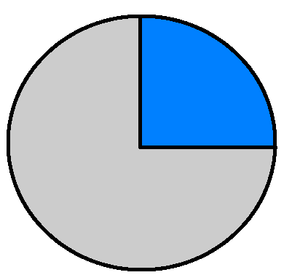
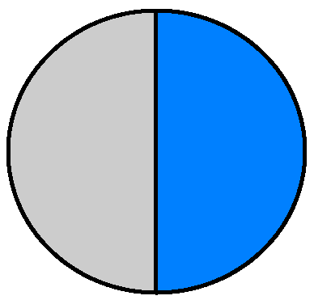
Pie Charts
Plant Growth Chart
 | 1st Plant | 2nd Plant | 3rd Plant | 4th Plant
Fertilizer 1 | 18 cm | 16cm | 19cm | 21 cm
Fertilizer 2 | 22 cm | 19cm | 24 cm | 17cm
Pie Charts help us look at fractions of a whole. Percentages and fractions represent what proportion of a group had a certain result.
For example, we decide to do the plant experiment three more times and record the final heights of each plant in the table on the right. Now we want to see what fraction of the plants grew over 20 cm for each fertilizer.
Fertilizer 1 only had 1 in 4 plants grow over 20 cm. 1/4 is 25%
Fertilizer 2 had 2 in 4 plants grow over 20 cm. 2/4 is 50%
25% Grew over 20 cm
50%
50% Grew over 20 cm
75%
Fertilizer 1
Fertilizer 2
Notes:
Looking at data from as many perspectives as possible helps draw the most accurate and well-rounded conclusions possible. In this example, the data is displayed in terms of trials and percentages. Since both fertilizers were able to achieve heights of at least 20cm, it is important to look at which fertilizer was more AFFECTIVE overall in creating plants that reach a certain height. This gives yet another aspect to the data that can not be easily shown by just looking at the chart.

Slide 22
Final Conclusion
With the help of our Scatter Plot and Line Graph, we can see that both plants start growing similarly, but Plant A starts to slow down around 15cm while Plant B keeps growing at the same rate.
After performing multiple trails, we see that Fertilizer 2 almost always grows taller plants with half of them growing over 20 cm in 4 days.
We notice on one occasion that Fertilizer 1 grew a taller plant. How does this affect our conclusion?
Would you feel confident telling your friend that if they used Fertilizer 2 as opposed to Fertilizer 1 that they would have taller plants?

